Slide 1
Provincial and Territorial Economic Accounts at StatCan
Presented at: UN Sub-National Statistics Sprint Webinars, September 3, 2025
By: Guillaume Dubé, Assistant Director, Industry Accounts Division

Slide 2
Presentation outline
    Statistics Canada and Canadian System of Macroeconomics Accounts
    Provincial and Territorial Economic Accounts in Canada
    Accounts, data sources, and methods
    Revision cycle
    PTEA challenges
    Consistency with external economic estimates
    Additional information

Slide 3
Statistics Canada and Canadian System of Macroeconomics Accounts
    In Canada, providing statistics is a federal responsibility. As Canada’s national statistical office, Statistics Canada is legislated by the Statistics Act to serve this function for the whole of Canada and each of the provinces and territories.
    The country’s national statistical agency ensures Canadians have the key information on Canada's economy, society and environment that they require to function effectively as citizens and decision makers.
    Canada's macroeconomic accounts are produced by the Macroeconomics Accounts Branch. They consist of a set of accounts, each one providing an aggregated portrait of economic activity during a given period.
    This includes the full set of accounts with the System of National Accounts framework.

Slide 4
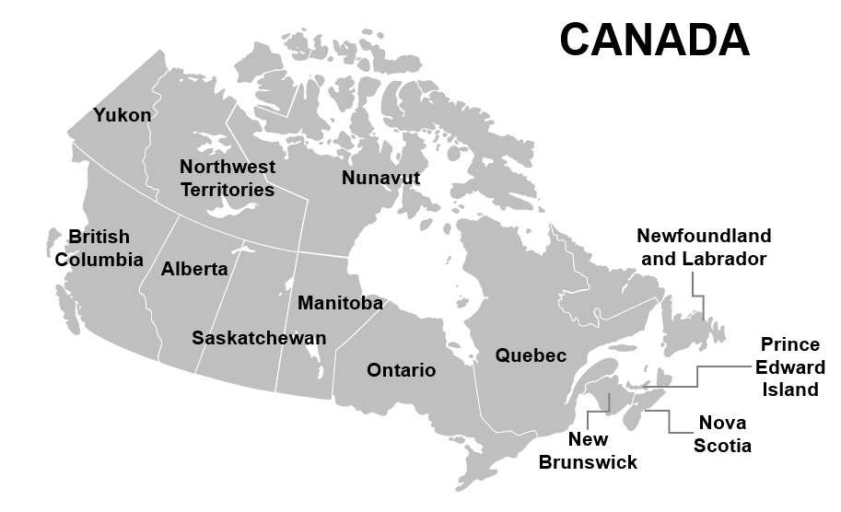
Statistics Canada and Canadian System of Macroeconomics Accounts
Canada has a hierarchical system of sub-national geographies used for statistical and administrative purposes.
The main sub-national geographic levels include 13 Provinces and Territories.

Slide 5
Provincial and Territorial Economic Accounts in Canada
Provincial-Territorial Economic Accounts (PTEA) in Canada include:
  Supply and Use Tables
  Income and Expenditure accounts (GDP by income and expenditure)
  Industry Accounts (GDP by production)
Data availability for the 13 geographies
  Income and expenditure accounts start in 1981
    including detailed government and household sector accounts
  Industry accounts start in 1997
  Supply and Use tables start in 2010
    Release
      Coordinated release in early November of each year
      Industry accounts has a flash release 4 months after the reference period in the spring of each year
    Accessibility
      All StatCan data are available free of charge in a Common Output Data Repository on its website

Slide 6
Background of the PTEA
Provincial-territorial data sources underwent a massive overhaul in the 1990s with funding from the federal government under the ‘Project to improve provincial economic statistics’ (PIPES).
  Improvements to existing annual surveys to capture provincial-territorial information, development of enterprise-based business surveys
As a result, the PTEA estimates are used for the calculation of important financial transfers between federal and provincial/territorial governments.
  Allocation of sales tax revenues to jurisdictions participating in the Harmonized sales tax program (collected by the federal government)
  Fiscal arrangements allocation to provinces (through Equalization payments) and territories (through Territorial formula financing) to maintain an average fiscal capacity across all jurisdictions

Slide 7
Background of the PTEA continued
The Supply and Use Tables (SUT) are a core component of Canada's macroeconomic accounting system. They provide a detailed snapshot of the Canadian economy by tracking the production of goods and services by domestic industries, plus imports and how these goods and services are consumed - either as intermediate inputs by industries or as final consumption, investment, or exports.
The Income and Expenditure Accounts (IEA) are fully consistent with the SUT by province-territory for the SUT reference year and many IEA series use the SUT estimates as the benchmark.
The Industry accounts are a projection of gross value added by industry from the SUT to the current period using a broad range of indicators (e.g., production, labour inputs, physical volumes, etc.).

Slide 8
Supply and Use Tables
SUT provide a wealth of information about the structure and evolution of the Canadian economy.
They are produced annually for Canada and 13 provinces and territories including outside Canada.
Classifications:
    The detailed industries (233 industries) are based on the North American Industry Classification System (NAICS) and are classified using the Supply and Use Industry Classification (SUIC)
    The commodities (total of 470) are classified using the Supply and Use Product Classification (SUPC), which is largely based on the North American Product Classification System (NAPCS)
    The final demand categories (136 at the detail level) are classified according to the Input-Output Final Demand Classification (IOFDC) system.
The tables are released 33 months following the reference period due to the detail required and the complexity of compilation.

Slide 9
Supply and Use Tables
The SUT framework combines all 3 approaches of estimating GDP by balancing the supply and use of every product, thereby generating consistent estimates of GDP from both the production and expenditure sides
Coherence: A powerful tool with which to compare and contrast data from various sources and thereby improve the coherence of the economic information system
Initial estimates to fill the cells of the SUTs come from various sources
  Surveys of industry,
  Survey of household spending
  Survey of capital expenditure
  Tax data (T1, T2, T4, Other)
  Customs data
  Government finance statistics
  Other administrative data and external reports and statistics
  Product information is very important

Slide 10
Income and expenditure accounts
    Presentation for Provincial-territorial (PT) income and expenditure accounts is identical to that of the quarterly national program, except for interprovincial trade flows
    Over 800 data (nominal) estimates by region within the IEA (360 for trade alone), approximately 500 volume estimates (and prices)
    Sequence of accounts is available for 14 regions (13 provinces & territories and outside Canada)
      Sector accounts are only available for the household sector given that numerous corporations and non-profits would be considered national in scope
      Federal government is allocated to regions often using population and is considered illustrative

Slide 11
Income and expenditure accounts: data sources
    Certain series (such as housing, compensation, rent) are developed quarterly by region, where the national is the sum of the regions;
      certain input data sources include the regional information at a sub-annual basis, so compilation by region is possible sub-annually
    Others have regional details on an annual basis for the current period;
    Series without data sources by region use the benchmark level from the SUT, projected forward using the national growth rate.

Slide 12
Income accounts data sources
GDP components | Main data sources
Compensation of employees | income tax data includes the province of employment, whereas province of residence is used for sector accounts
Operating surplus of corporations | establishment based surveys, tax filings, energy surveys, projected from SUT benchmark
Consumption of fixed capital | from capital stock model, built using PT data on investments, depreciation profile in national by asset, prices are PT by industry
Gross mixed income (non-farm, non-rent) | tax filings (business declarations), labour force indicators used for some industries
Gross mixed income (rent) | developed at the PT level using a variety of data sources (housing stock in units, average rent from CPI, etc.)
Gross mixed income (farm) | compiled at the PT level from our Agriculture division (farm cash receipts, expenses)
Taxes less subsidies | reported data for local and provincial/territorial governments, federal government spread based on population

Slide 13
Expenditures accounts data sources
GDP components | Main data sources
Household consumption | survey of household spending, vehicle purchases by registration, surveys on retail and restaurants, energy admin data, financial based on bank filings & employment, insurance based on employment (as examples)
Government final consumption | by level of government (local, provincial/territorial), federal government split arbitrarily
NPISH final consumption | based on tax filings for non-profits
Capital investment: construction | sub-annual surveys for buildings have PT details, engineering from annual CAPEX survey with PT details
Capital investment: M&E | annual CAPEX survey, projected forward from SUT benchmark
Capital investment: IPP | PT ratios projected from SUT benchmark using national level surveys, own-account using PT jobs and wages
Non-farm inventories | business establishment-based surveys, energy surveys, tax data
International trade | Canada’s trade with rest of world is total, PT splits are based on SUT benchmark projected using Final demand and energy/mining surveys
Interprovincial trade | SUT benchmark projected forward using Final demand and energy/mining surveys

Slide 14
Income and expenditure account: deflation
    Only the expenditure accounts are estimated in both nominal and volume terms at the detailed level
    In most cases, the nominal is derived first which is deflated with prices to estimate the volumes
      certain components, such as energy trade flows are estimate on a volume level first
    Examples of prices with provincial-territorial dimension:
      Consumer price index
      Machinery and equipment price index (by industry, by PT)
      Building construction price index
      Own-account capital uses movement of wages
    There is limited data source for prices of trade flows by region, national prices are used for the most part

Slide 15
Income and expenditure accounts: Trade flows by region
    Inter-provincial trade flows measure the annual trade of goods and services between the provinces and territories, whereas international trade by province reflects annual trade between individual provinces/territories and the rest of the world
      Both are estimated for expenditure-based GDP by region;
    Developed by balancing the supply and demand for goods and services by province and within the SUT framework; beyond the SUT year, the modelled flows are confronted against energy/mining surveys and final domestic demand;
    Nuances with PT trade flows:
      definition of certain services is different in national versus provincial system therefore international trade of services is not equal between the two systems (total international trade is),
      Inter-provincial services require special attention: for example, insurance – there could be a disaster in one province, but the insurance company (and staff) are in another province. Therefore, we estimate an interprovincial trade flow of insurance services

Slide 16
Industry accounts
    Annual provincial-territorial GDP by industry is estimated for 226 industries plus 111 aggregates thence, including special aggregations such as ‘goods-producing industries’, ‘energy sector’, ‘public sector’ for each region
      various levels/aggregations permit targeted analysis and industrial performance reviews
    Data available 4 months after the reference period and revised at the time of the PTEA release, with incorporation of latest SUT
    Estimation method:
      SUT year: double deflation at the national and provincial-territorial level
      Beyond SUT year: project Output and gross value added in real terms using various indicators; sum of provinces benchmarked to national monthly GDP by industry.

Slide 17
Industry accounts continued
    Due to limited data sources, cannot estimate value added directly – as expenditures accounts – so partial indicators of an industry’s production function are used
      Principal outputs & employment
      Assumption of fixed real technology coefficients -> changes (real) in the indicator used (output, labour or usage) correspond to changes in (real) value added
    Deflation: price indexes or unit values (where quantities and prices are available)
    Main data sources:
      Supply and use tables for SUT reference year
      Output indicators (Statistics Canada surveys, financial reports), employment, goods and services tax (federal), price indexes, etc.
      Income and expenditure accounts: Output indicators such as investment (construction), household final consumption expenditures (personal services industries), government labour income and depreciation.

Slide 18
Revision cycle
Estimates of SUT, IEA and Industry accounts are released in the fall of each year.
This release also comprises revisions to the two previous years. Estimates are not normally revised again except when comprehensive revisions are carried out.
Statistical revisions are carried out in order to incorporate the most recent information from surveys, taxation statistics, public accounts, censuses, etc., as well as from the annual benchmarking process according to the Supply and Use Tables.

Slide 19
PTEA Challenges
    Although having three measures of GDP (income, expenditure and production) is a source of strength in the PTEA, it can also pose unique challenges.
Nominal estimates of GDP by income and by expenditure are perfectly reconciled, whereas volume growth rates from GDP by expenditure and GDP by industry (production) are aligned.
    Some regions are relatively small or are focused in one or two main sectors, in these cases, it is challenging to measure the correct growth rate.
    Derived estimates can show conflicting signals (for example surplus, output, and trade).
    Compilation requires not only integration of massive amounts of data, but confrontation against other data sources and economic logic.
    For years beyond the SUT year, the importance of an industry or sector at the PT level might not always be apparent within the national estimates (PT GDP by industry is benchmarked to the national GDP by industry)

Slide 20
Consistency with external economic estimates
    StatCan provides the official measures of GDP for all provinces and territories.
    Provincial statistics agencies can also produce their own set of estimates ahead of StatCan release.
      There are a number of reasons why it is the case
    Many factors can explain the difference in estimates
      Data sources and methods, timeliness and data availability, use cases, purpose, etc.
    StatCan has established good relationships over the years with region agencies
      Examples of collaboration include Annual meeting of the Federal–Provincial–Territorial Committee on Economic Statistics; validation of work-in-progress estimates, providing supplementary data information, planned consultation on main regional events, ad hoc working group meetings, etc.

Slide 21
Additional information
    PTEA annual releases:
      Provincial and territorial economic accounts, 2023: https://www150.statcan.gc.ca/n1/daily-quotidien/241107/dq241107a-eng.htm
      Provincial and territorial economic accounts: Interactive tool: https://www150.statcan.gc.ca/n1/pub/71-607-x/71-607-x2019022-eng.htm
      Gross domestic product (GDP) by industry, provinces and territories: Interactive tool: https://www150.statcan.gc.ca/n1/pub/71-607-x/71-607-x2019024-eng.htm
      Supply and use tables, 2021: https://www150.statcan.gc.ca/n1/daily-quotidien/241107/dq241107e-eng.htm
    Sub-annual components:
      Stock and consumption of fixed capital - quarterly capital stock program: https://www150.statcan.gc.ca/t1/tbl1/en/tv.action?pid=3410016301
      Wages and salaries: https://www150.statcan.gc.ca/t1/tbl1/en/tv.action?pid=3610020501
      Housing stock in units: https://www150.statcan.gc.ca/t1/tbl1/en/tv.action?pid=3610068801

Slide 22








Stay connected!
StatsCAN app
Eh Sayers podcast
StatsCAN Plus
The Daily
Website
Surveys and statistical programs
Data service centres
My StatCan
Questions? Contact us: infostats@statcan.gc.ca

Slide 23



Statistics Canada—
Your National Statistical Agency
Delivering insight through data for a better Canada

